Slide 1


“It’s amazing because you can do two add twos and we call them plus as well or altogethers! Ha ! . We get to use lots of things and we are always busy. “
“Reception makes me happy because its fun!”
“You learn lots of things by doing stuff and you can learn from the teacher too! “
“Reception makes me happy because the teachers are funny they always make me laugh”

Slide 2
The Start of Our Day

Slide 3
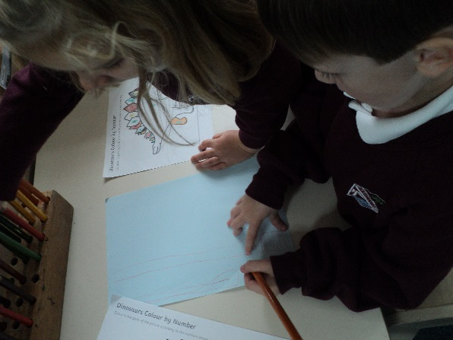
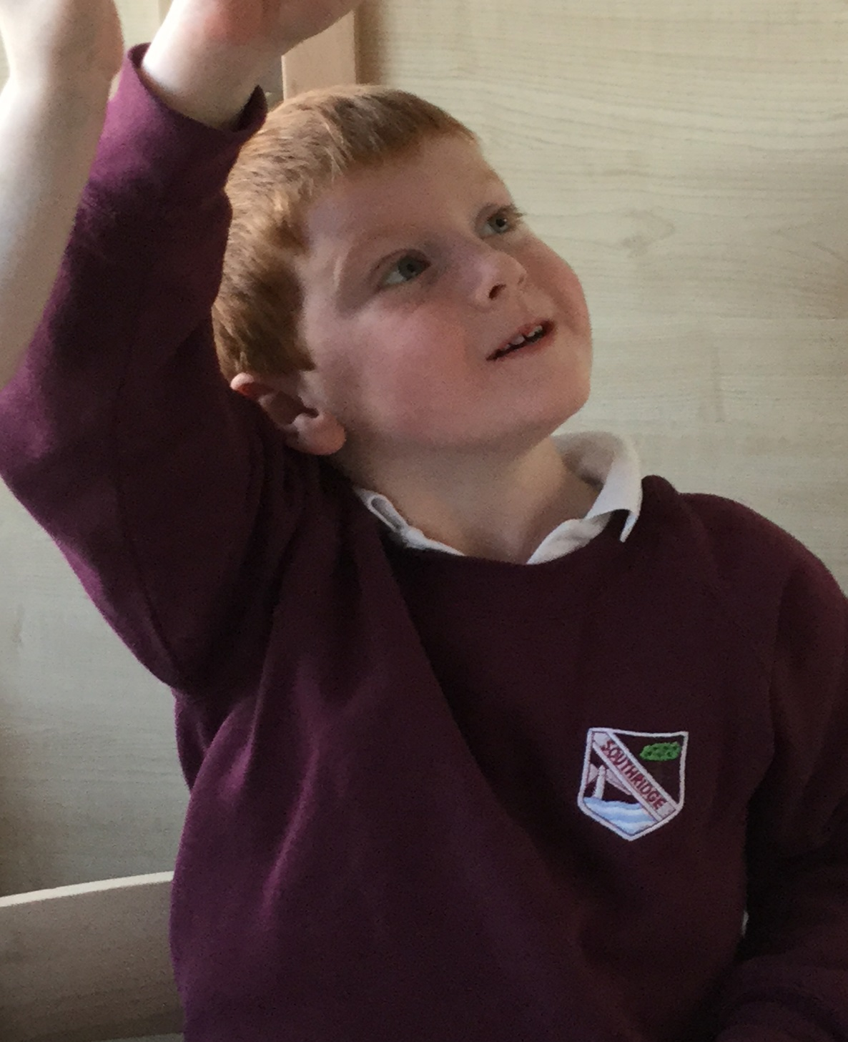
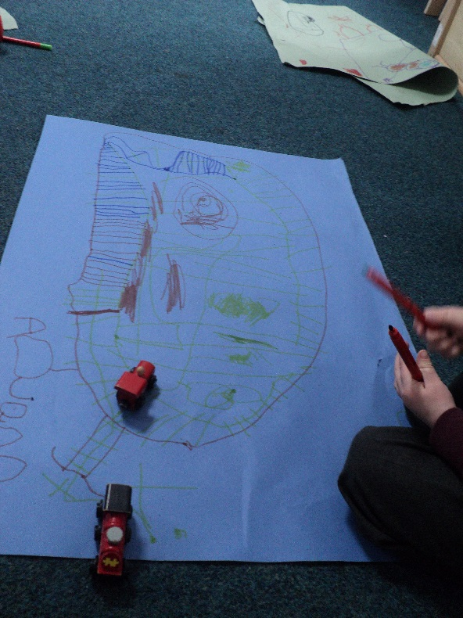
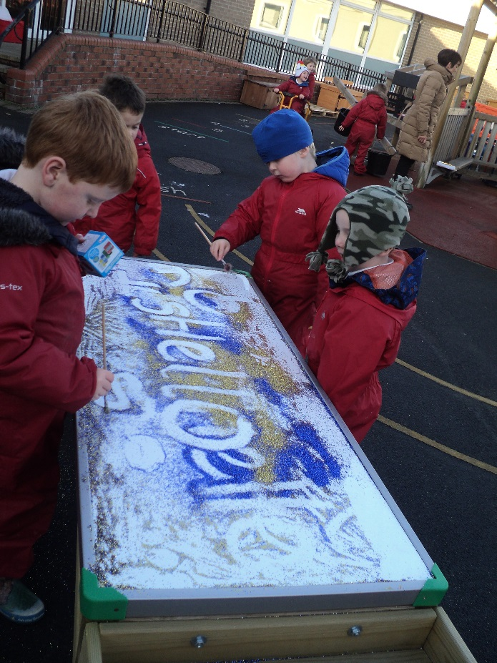
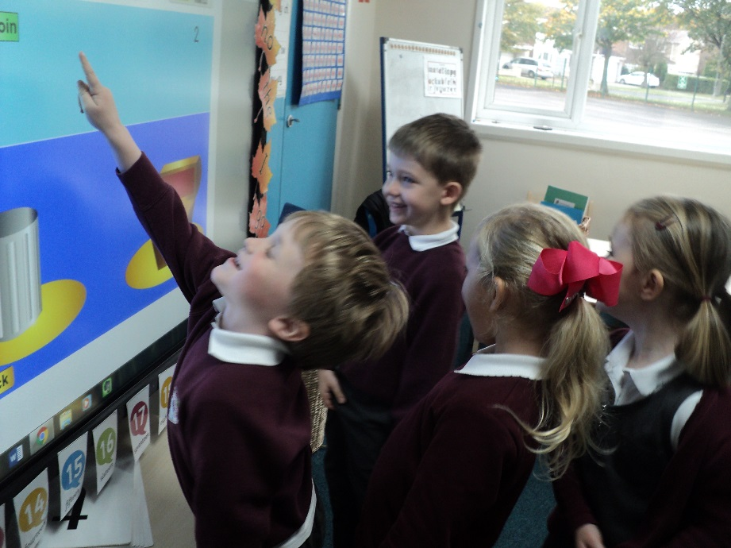

Slide 4
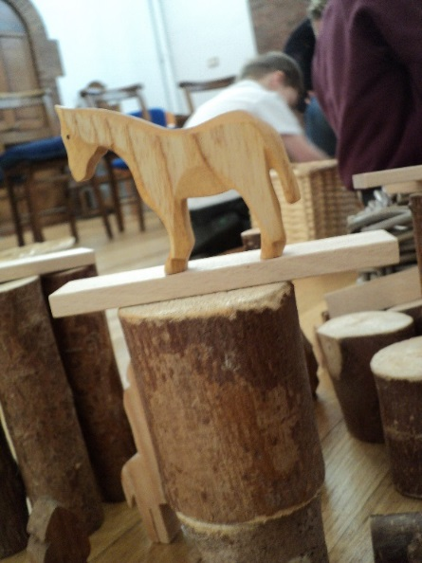
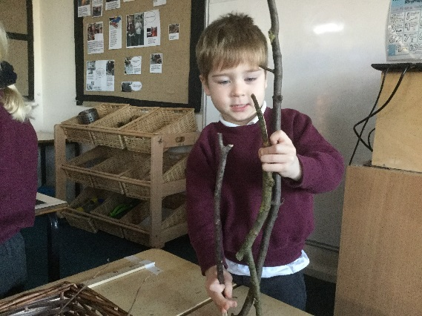
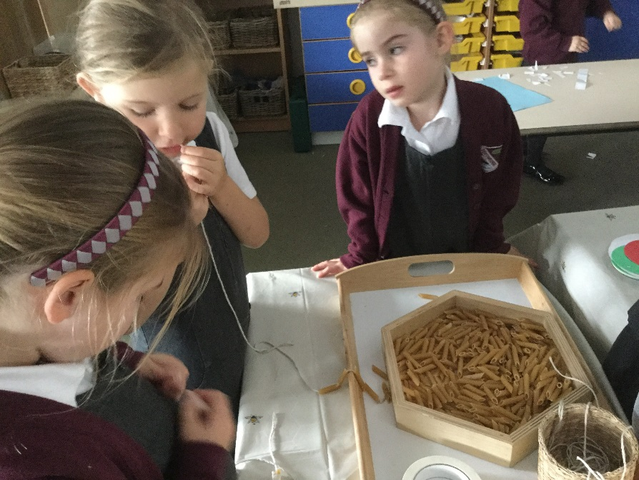
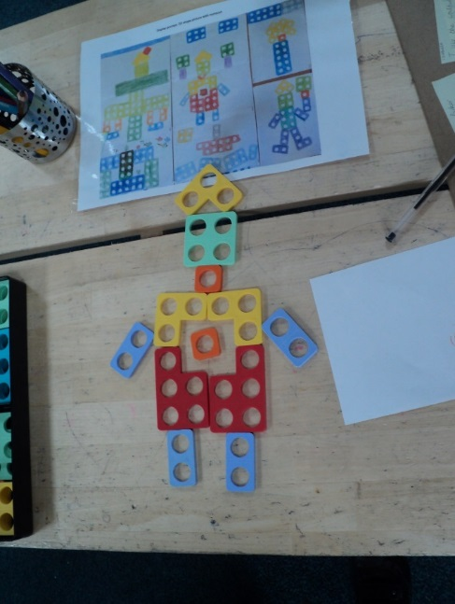
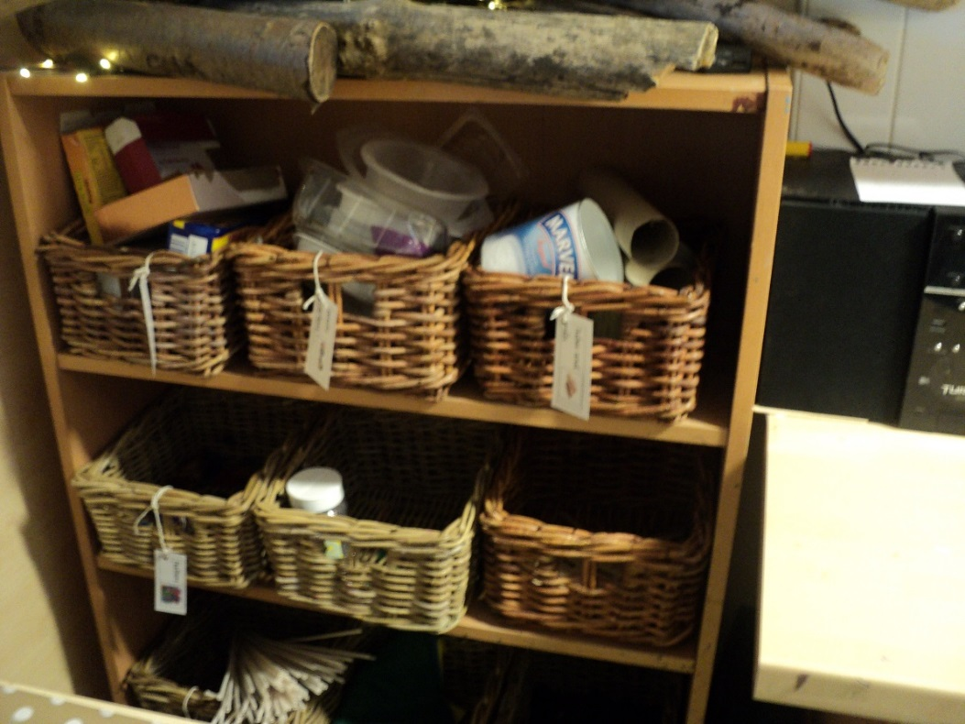
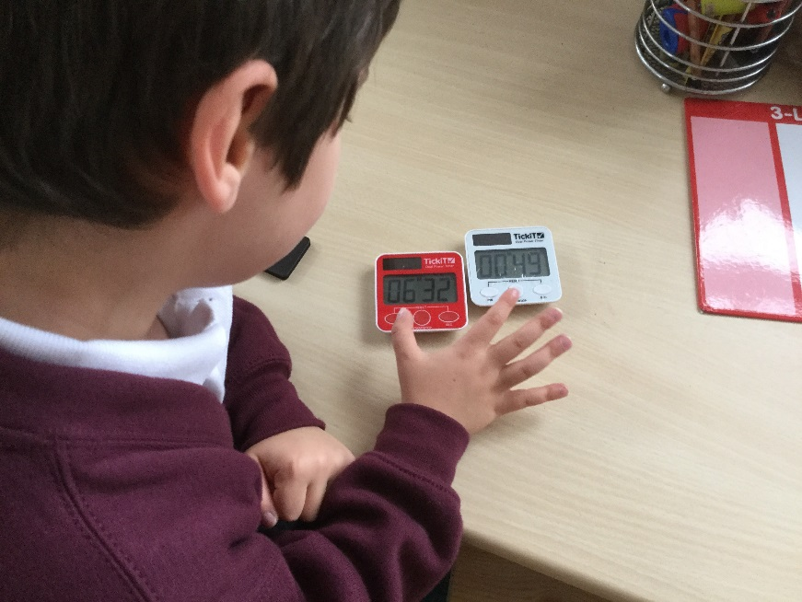
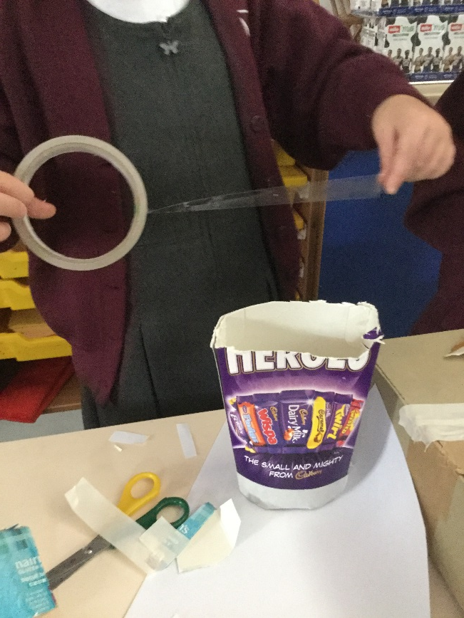

Slide 5
Partnership with Parents
We know that when parents and practitioners in the early years work together what a direct impact it has on children’s development and learning. Both partners have much to learn from one another and a great deal to share with each other. Working together to really understand and meet a child’s individual needs begins with valuing and respecting the different roles that each partner plays. It is a process that involves sharing information and skills and building relationships based on mutual respect and trust. Open two-way communication is vital to make sure that knowledge and expertise is shared between partners. Central to all partnerships is the child who remains the priority.
Learning journals are an important aspect of our children’s development.
playing and exploring - children investigate and experience things, and ‘have a go’;
active learning - children concentrate and keep on trying if they encounter difficulties, and enjoy achievements; and
creating and thinking critically - children have and develop their own ideas, make links between ideas, and develop strategies for doing things.

Slide 6
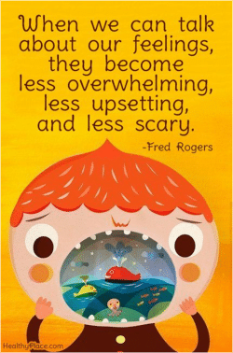
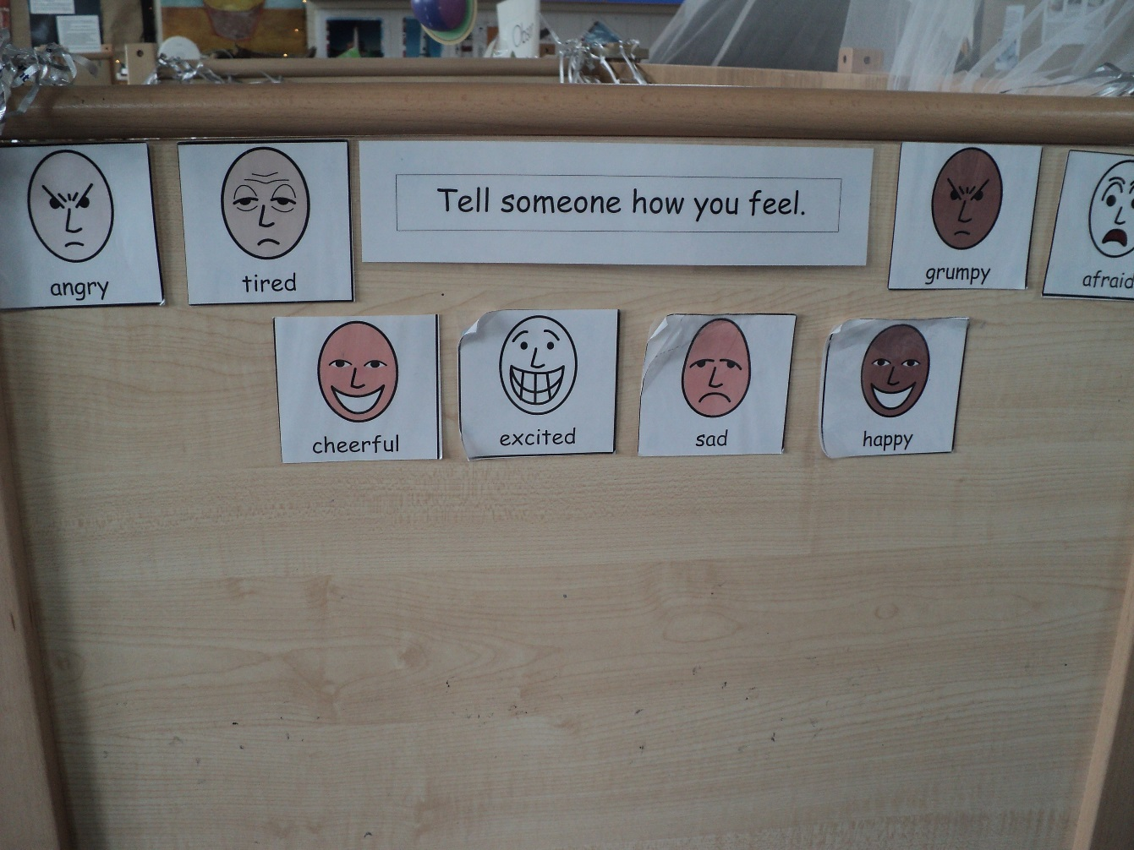
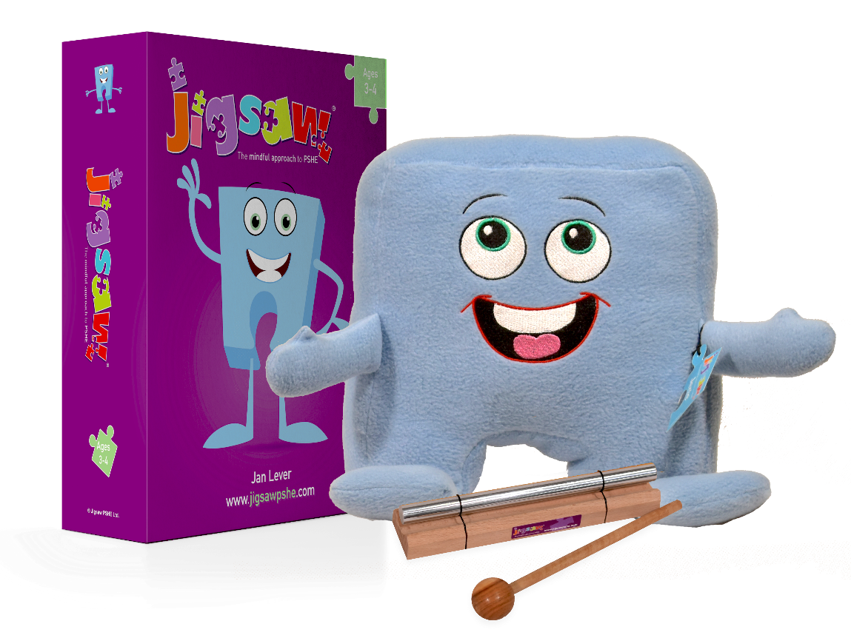

Slide 7
Newsletters

Slide 8
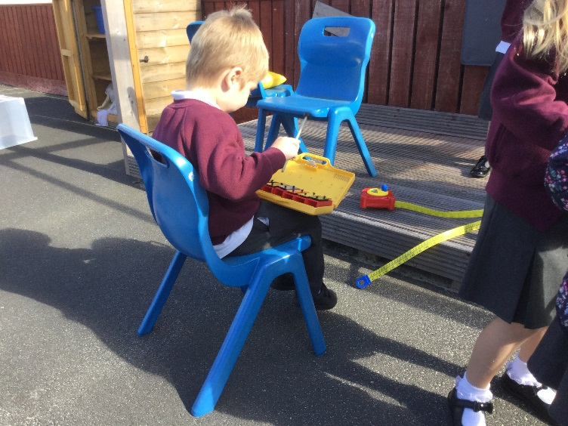
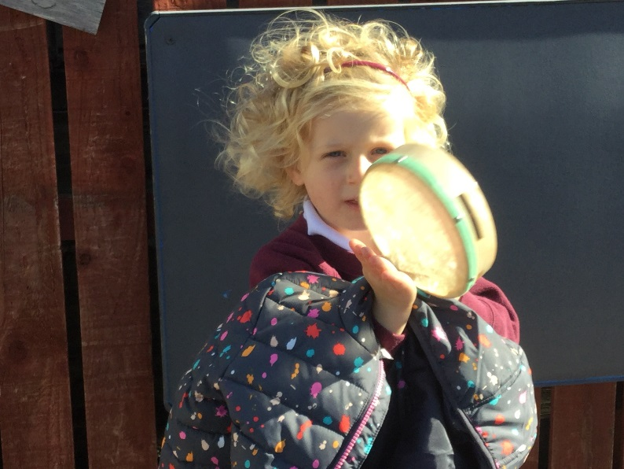
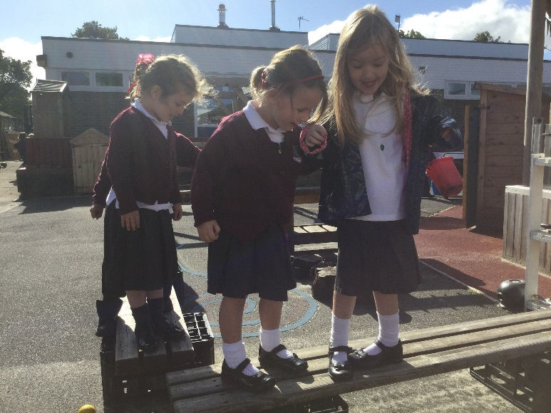
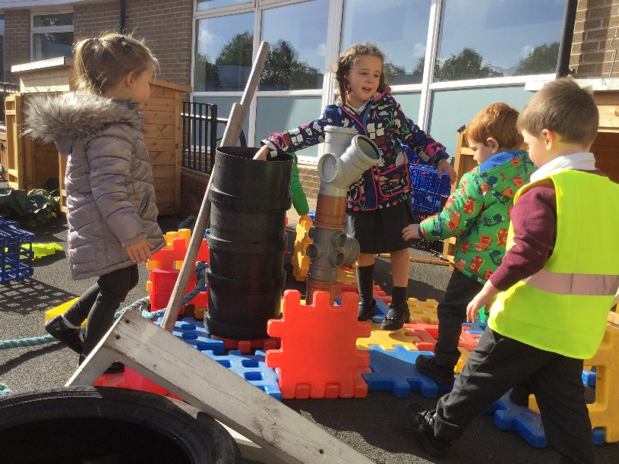
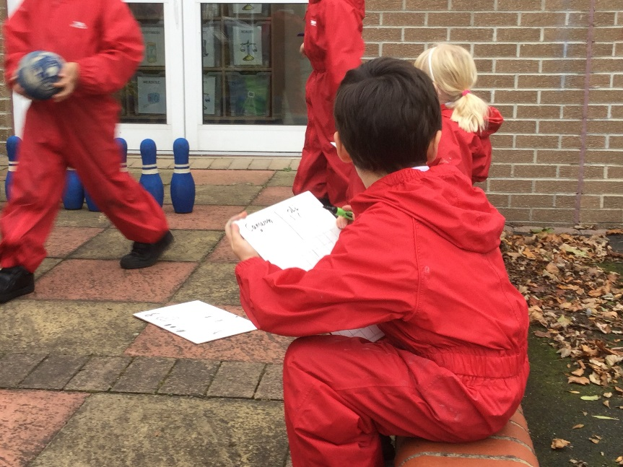
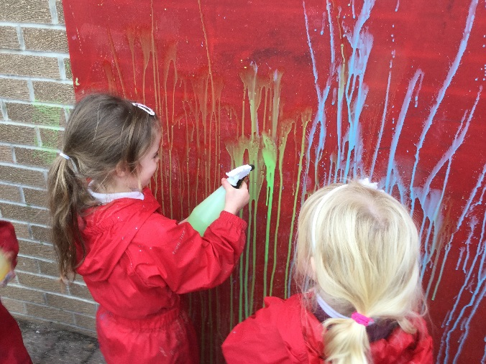
“The best classroom and richest cupboard is roofed only by the sky” .
Margret McMillan

Slide 9
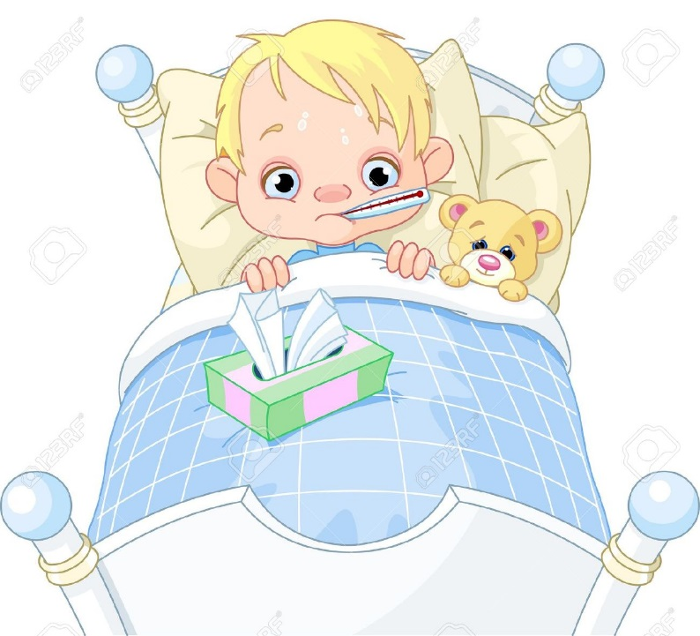

Illness , Accidents and Medications.

Slide 10
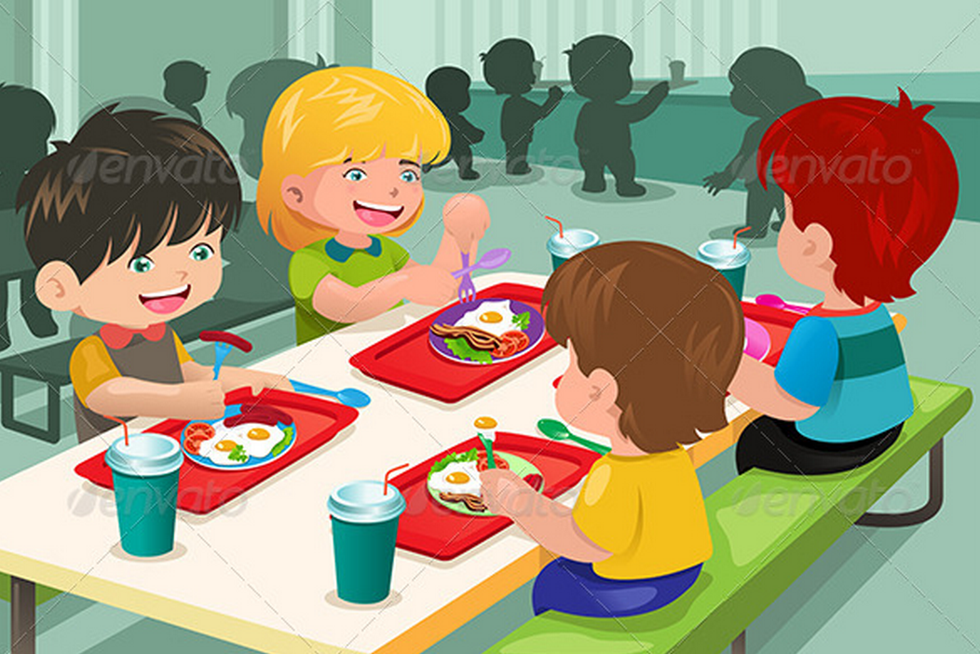


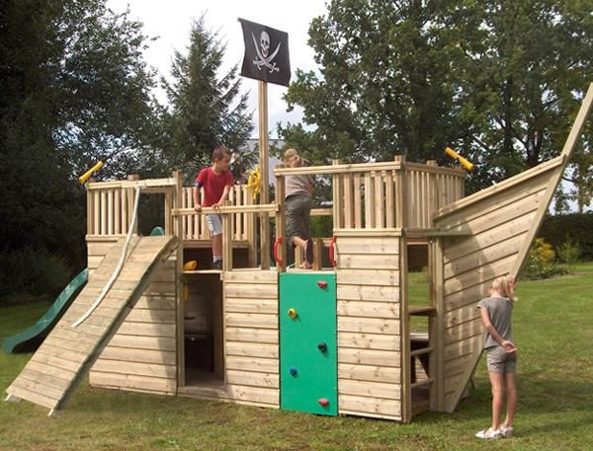
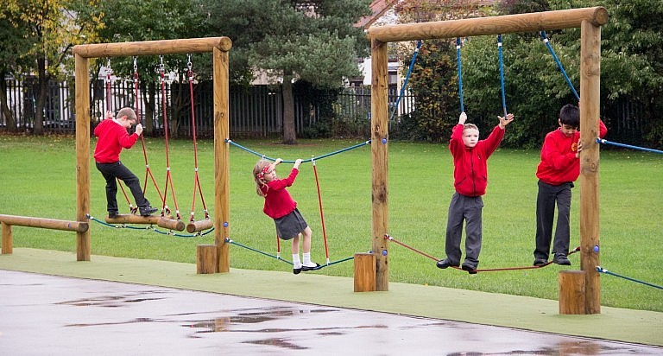


Slide 11
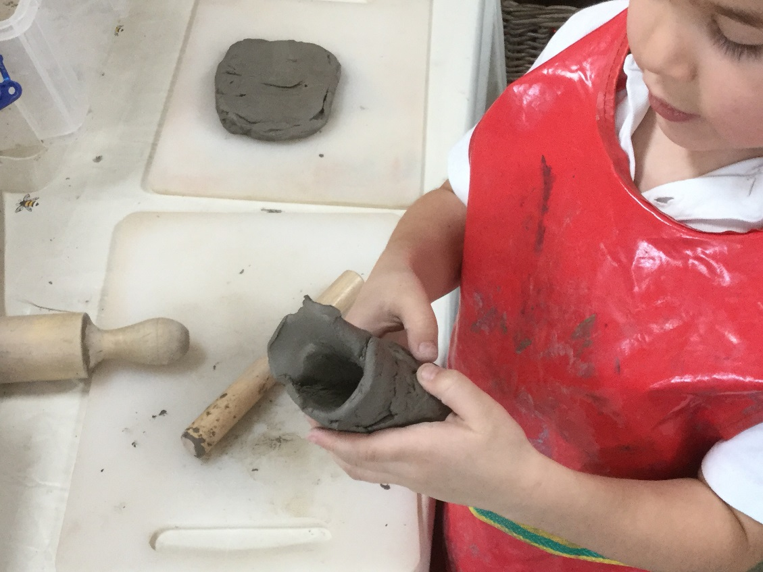
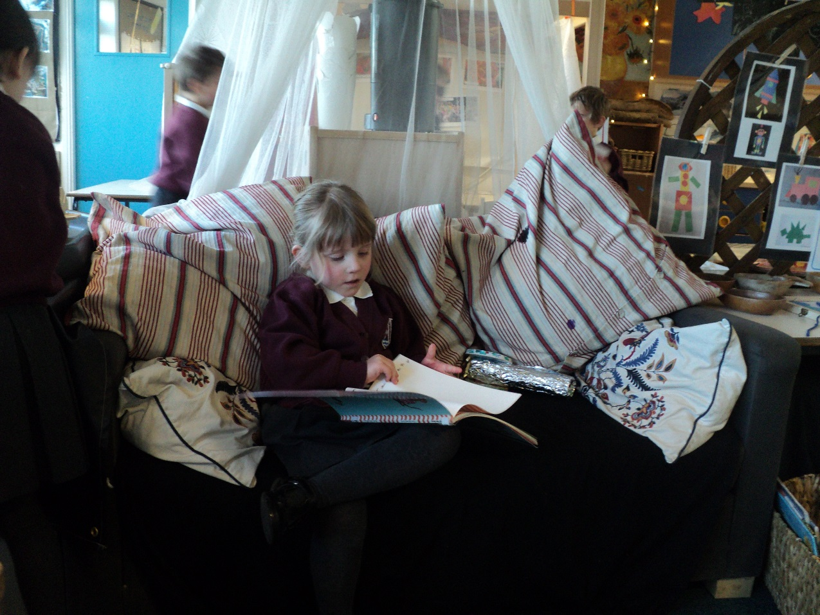
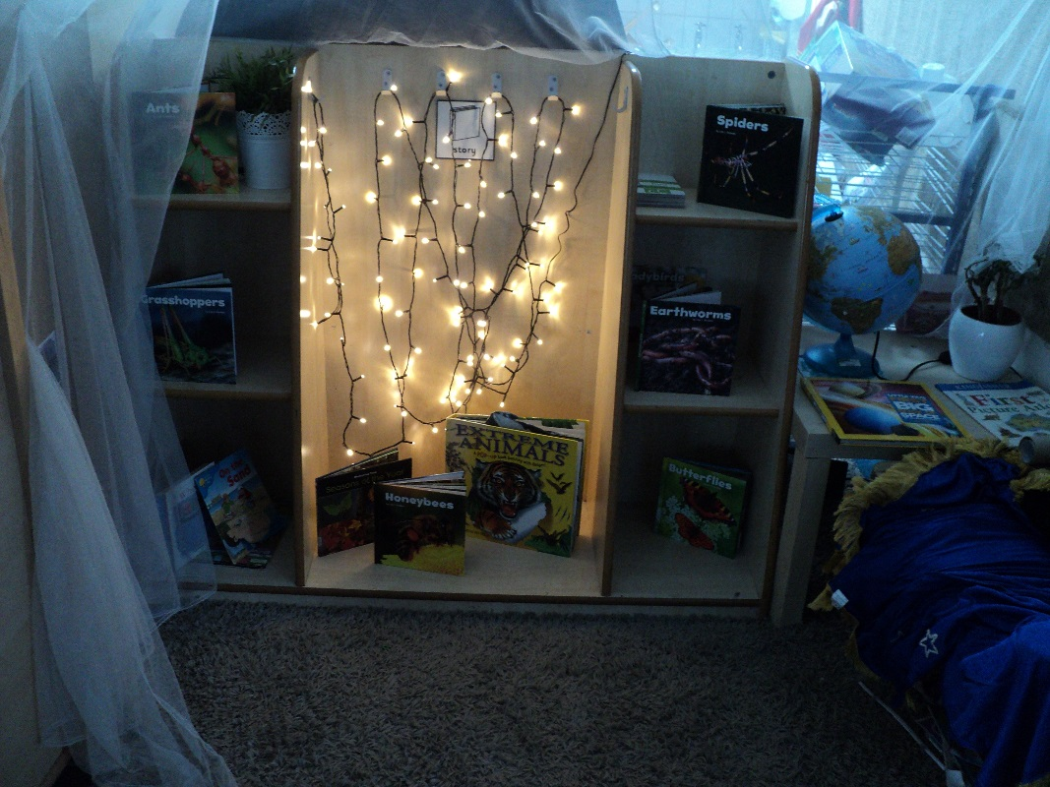
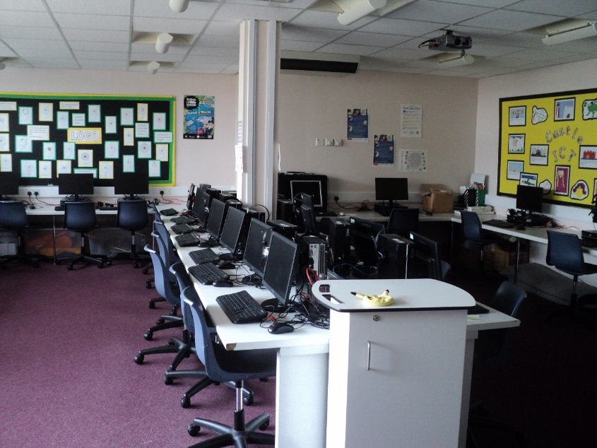

Slide 12


Slide 13
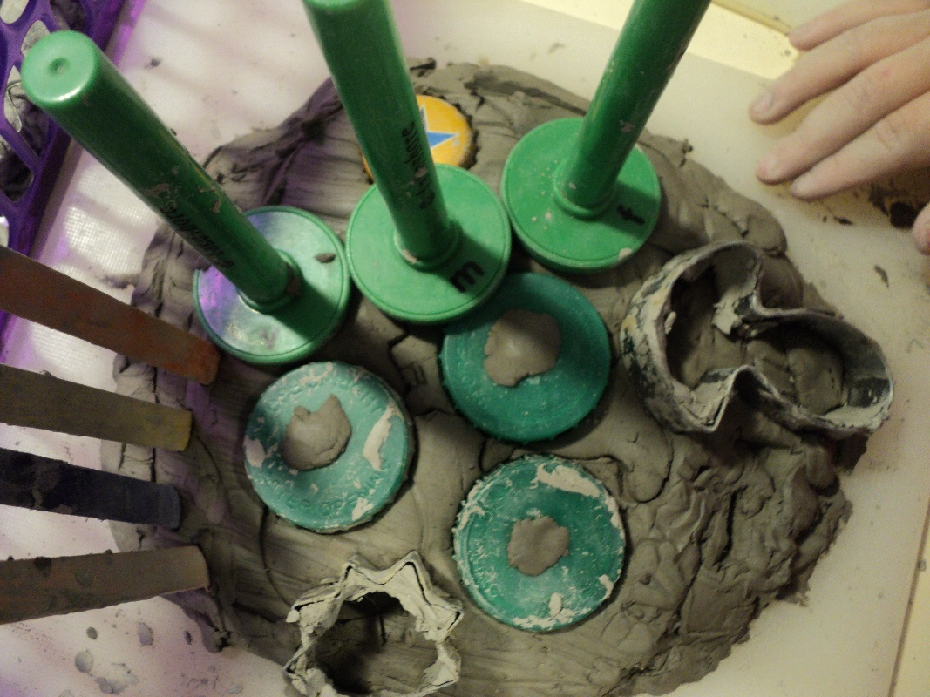
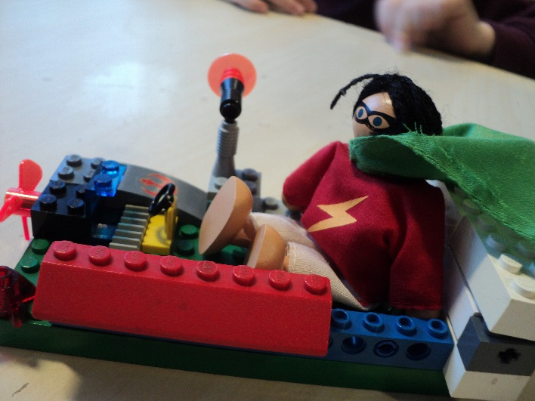
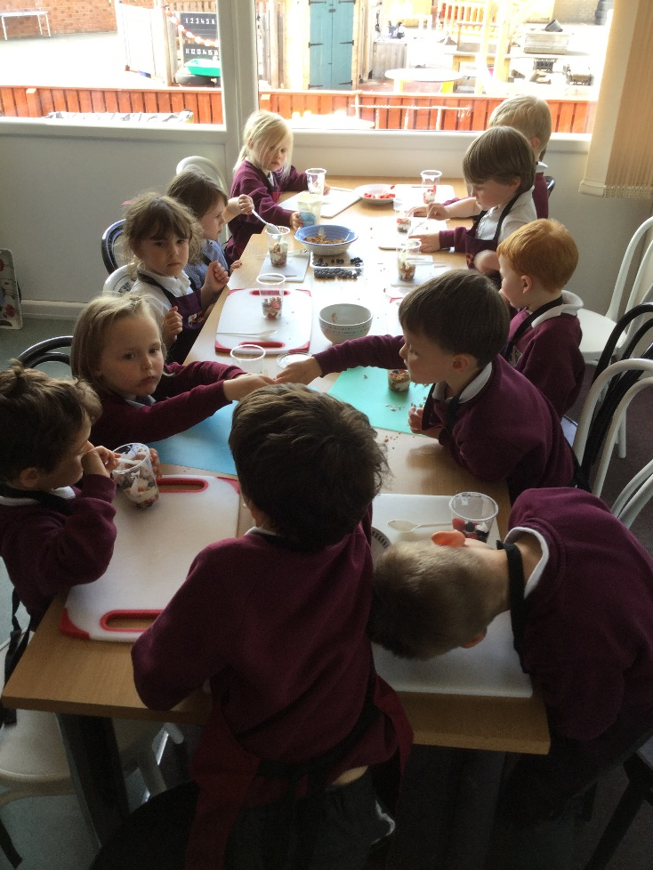
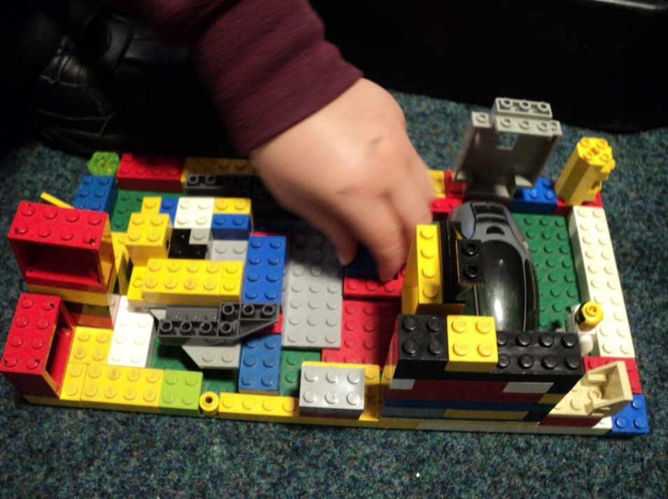


Slide 14
