Slide 1
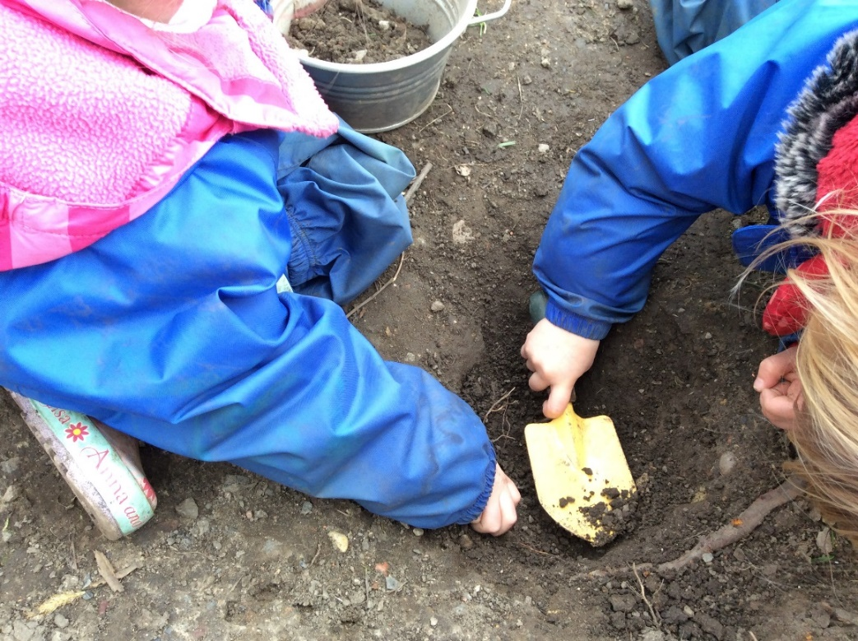
Welcome to Southridge Nursery 2023

Slide 2
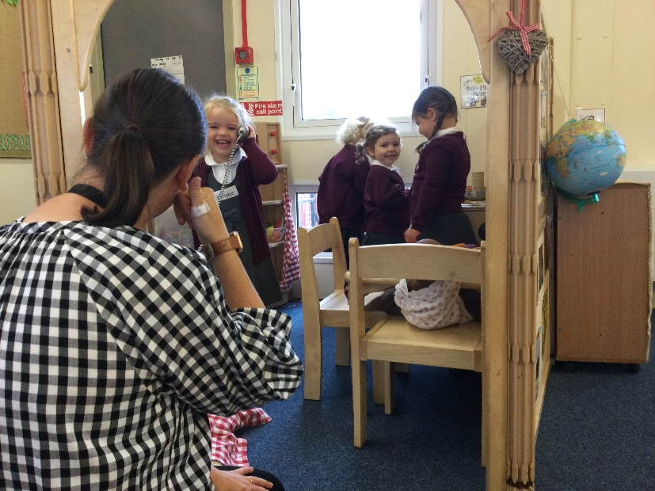
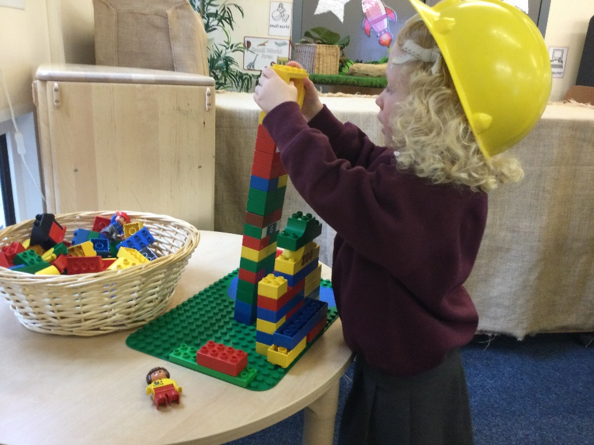
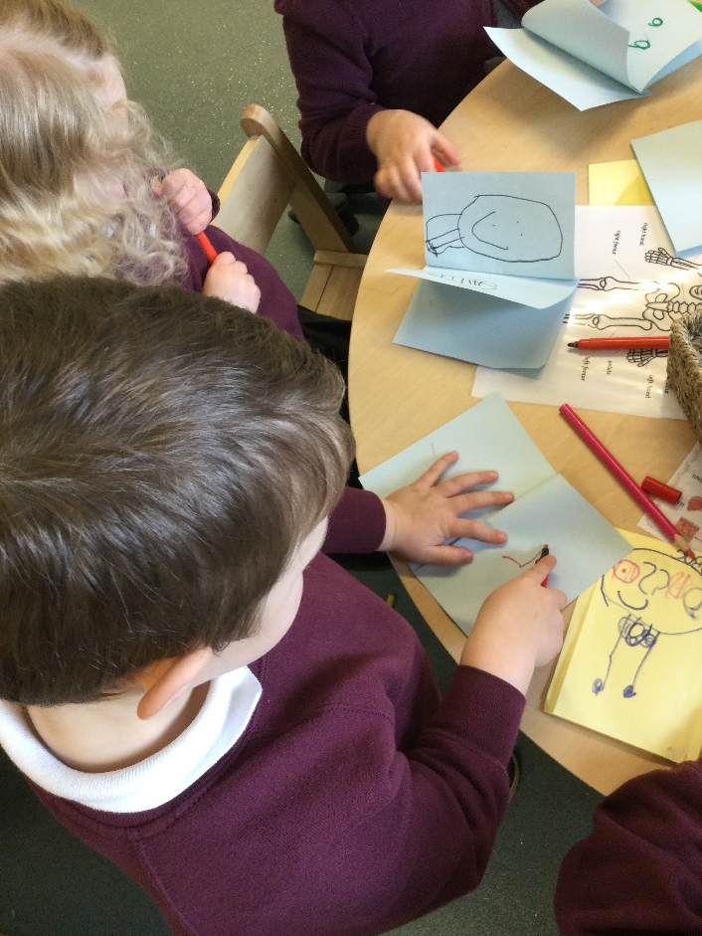
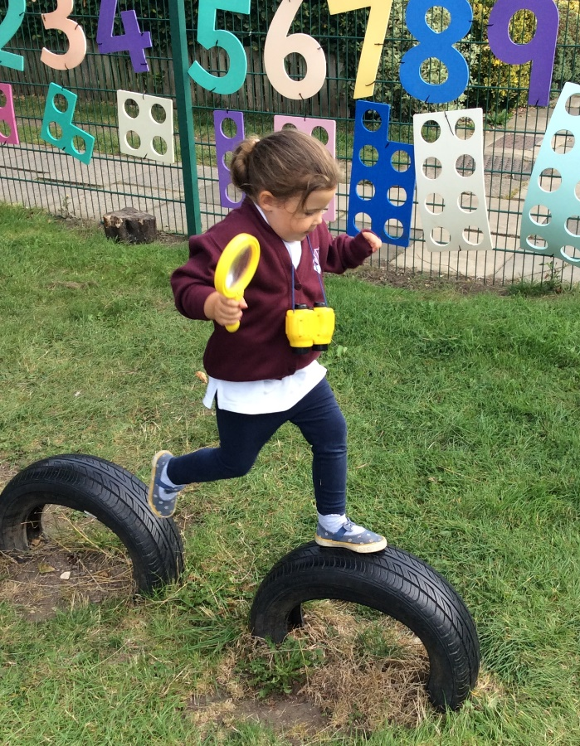
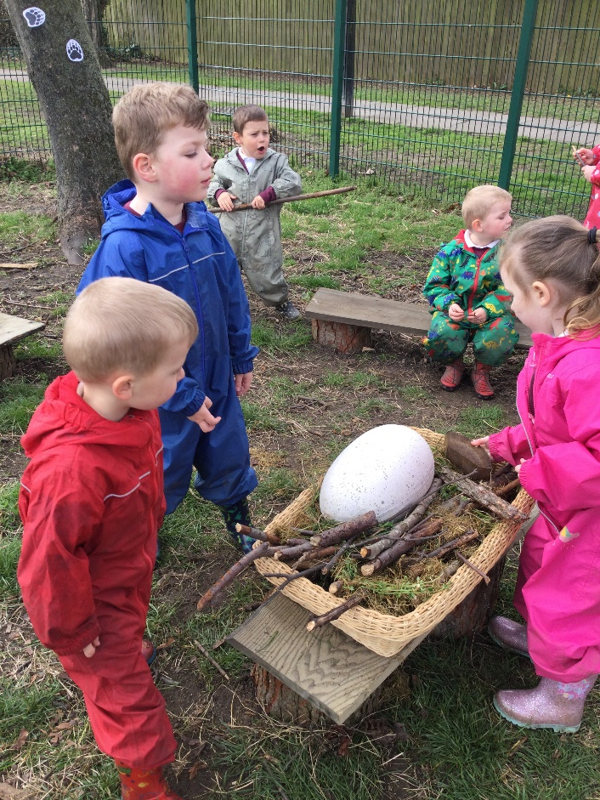

Slide 3
Summer visit sessions Wednesday 5th July
Each child will have one visit to the Nursery with a parent/carer for 45 minutes. This is an opportunity to play inside and outside and talk to Nursery staff.
September staggered start 5th – 8th September
All children will have one full session at Nursery in a small group. They will then all start on Monday 11th September.
Nursery sessions begin at 8:45am and 12:30pm prompt. At home time we operate a flexible pick up: 11:30-11:45am and 3:15-3:30pm.
Notes:
It is important that all children come in on time to ensure we can start our session promptly.

Slide 5
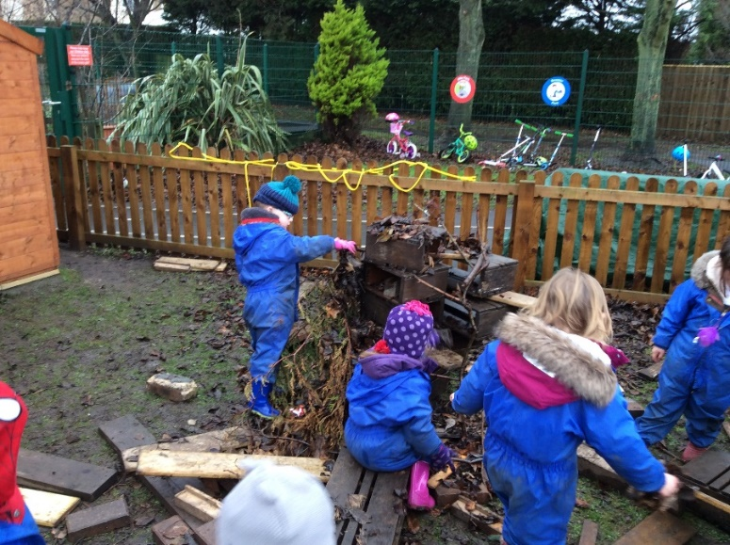
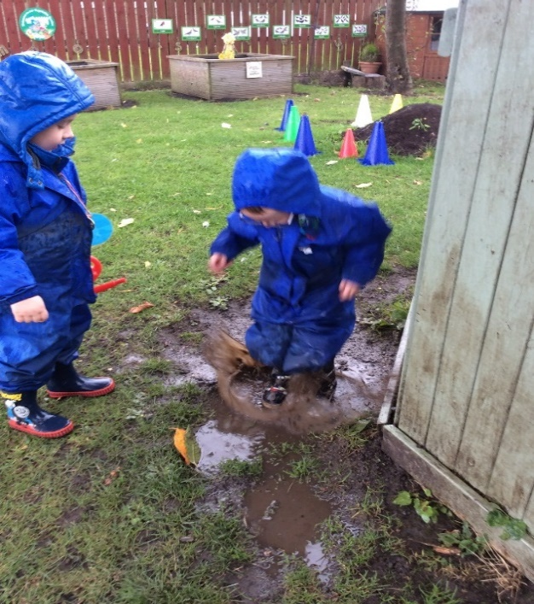
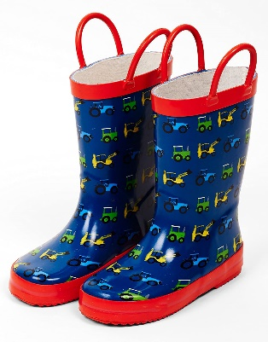
Learning Outdoors
We love to play outside in all weathers so we need to be prepared because it can get very wet and muddy!
Please provide a pair of wellies and a waterproof suit for children to keep at Nursery.
Please don’t send children to Nursery in their best coat – mud gets everywhere!
We would also ask that shoes are easy for children to manage themselves – velcro is best!

Slide 6
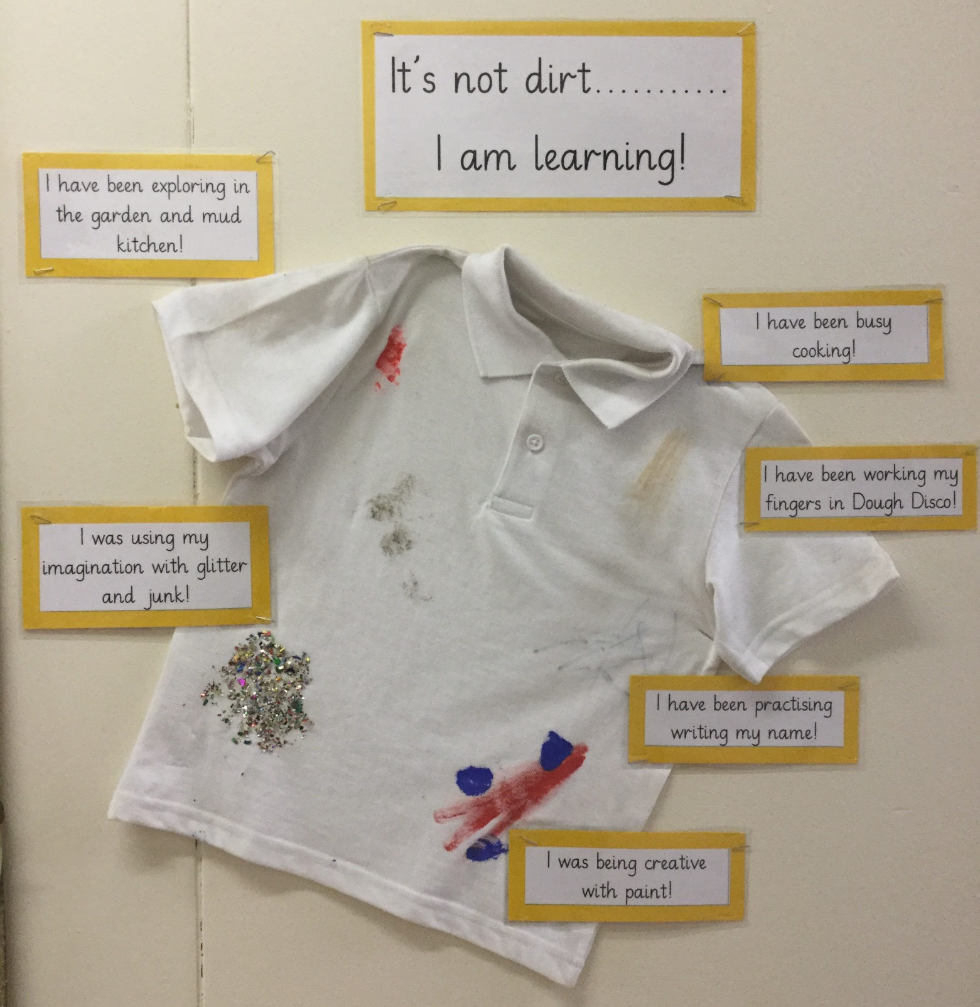
Think of your child’s uniform as overalls for learning.
We will be getting very messy whilst cooking, exploring, investigating, being creative and much more. Do expect your child’s uniform to get dirty!
We recommend buying a pack of inexpensive white polo t-shirts such as the ones you might get in the supermarket.
Tracksuit bottoms and leggings are ideal for children to pull up and down by themselves when going to the toilet.

Slide 7
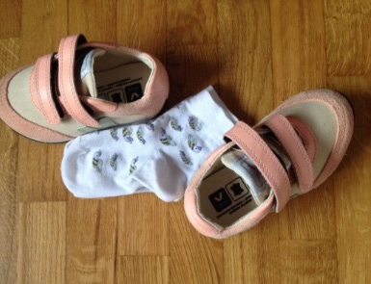
Taking off and putting on their shoes and socks.
Talk positively about Nursery.
Taking off and putting on their own coat.
Encourage them to ask lots of questions and listen to others.
Washing and drying their hands.
Help your child prepare for Nursery
Wiping their own nose.
Going to the toilet independently. If you have any concerns about this, please ring us or make a note of this in your child’s ‘All About Me’ book.
Read lots of stories together and sing songs and rhymes.
Recognising the picture on their name card.

Slide 10
What is important to us?
In Nursery we want to encourage children to:
Be independent and interdependent
Develop a ‘can do’ attitude
Show curiosity about the world
Begin to solve problems
Show a kind and caring attitude towards others
Celebrate their own achievements as well as those of others
Work as part of a team
In Nursery we want you as parents to:
Join us on your child’s learning journey – you play a huge part in it!
Feel you can always talk to us about any questions or concerns you have.
Read our weekly newsletter which will be sent to you electronically.

Slide 12
Well-being and Mental Health
From September we are launching a new whole school mental health initiative with Blue Mental Health Education and Training.
Focus: develop partnership between Blue, parents and school staff; all working together to promote the health and well-being of your child(ren).
Key Aspects:-
Developing ways of supporting all children in school, and particularly those with low level anxiety.
Developing a common understanding, approach and vocabulary for supporting our children both in school and at home.
September training day will launch the project and provide initial training for staff.
Evening sessions will be timetabled from the autumn term to which parents and carers will be invited. These will be led by representatives from Blue and will likely be hosted at our feeder Middle School – Valley Gardens. (More information will follow in the September Newsletter.)
Please feel free to find out more about Blue Mental Health and Education Training at www.bmhet.co.uk

Slide 13
Please fill out any forms sent from our school office and return them ASAP along with your child’s ‘All About Me’ booklet (before the end of the school term). This will help our staff get to know your child quickly.
If you have any questions, please do not hesitate to contact us via the school office.
We are very much looking forward to meeting you all soon.

Slide 14
